Slide 1
Image segmentation by Grover Algorithm
Team: Voyager
Members: Hoyeon Kook, dasan kim, huihun kim byoungoh hwang , bumkyu park,
Mentor: saesun kim

Slide 2
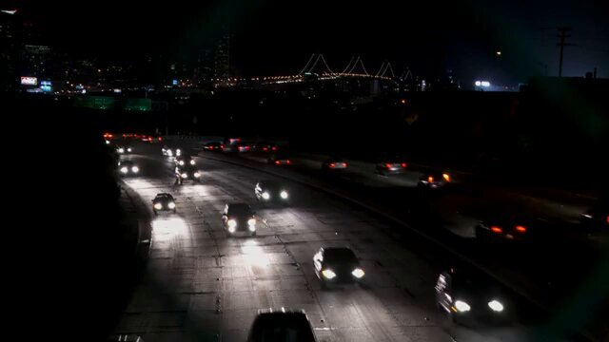
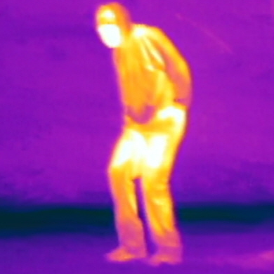

About the project
A fast target detection method (car’s headlights, infrared camera, etc…)

Slide 3
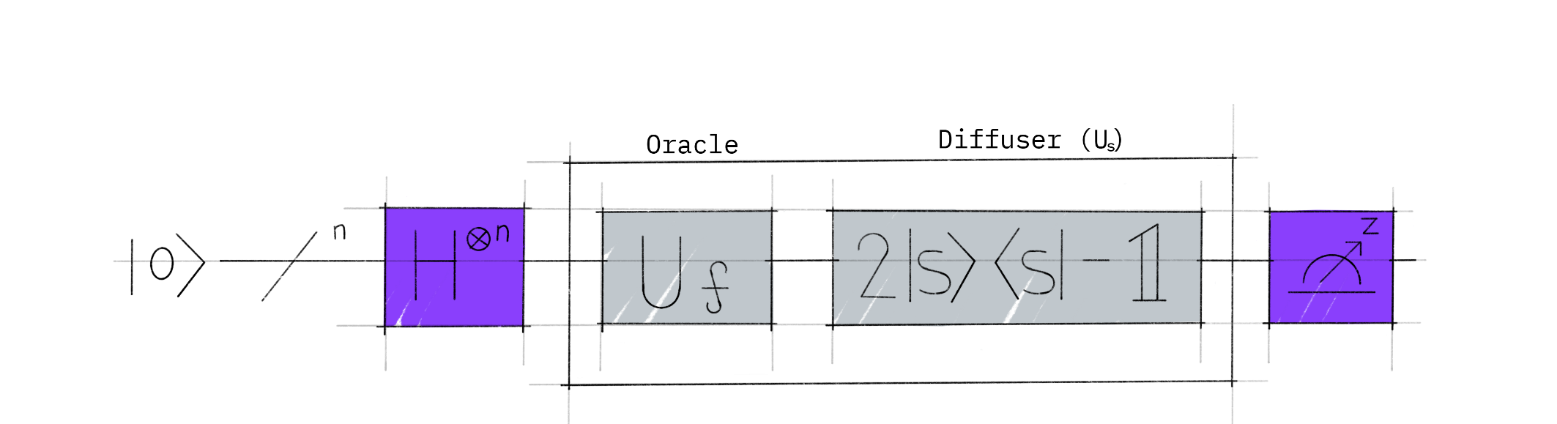
What is Grover’s Algorithm?
H Gate:
Superpositioning the qubits
Oracle:
Checking the answers
Diffuser:
Amplifying the probabilities
Picture Source: https://qiskit.org/textbook/ch-algorithms/grover.html
Paper Source: Lov K. Grover, 「A fast quantum mechanical algorithm for database search」, 19 Nov 1996

Slide 4

Why did we use Grover Algorithm?
Saving times effectively
0
1
0
1
N times
$\sqrt{N}$ times!!
Answer received
Answer received
<Normal Algorithm>
<Grover Algorithm>

Slide 5
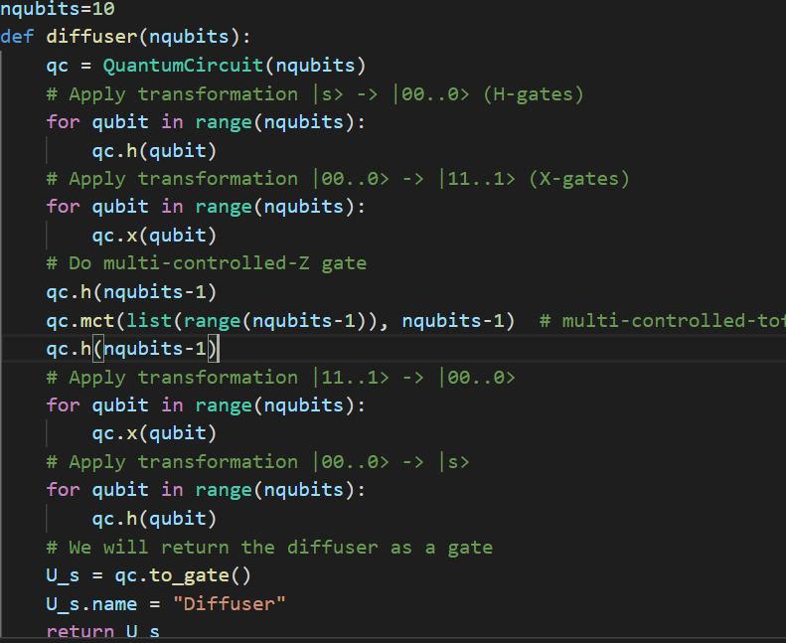
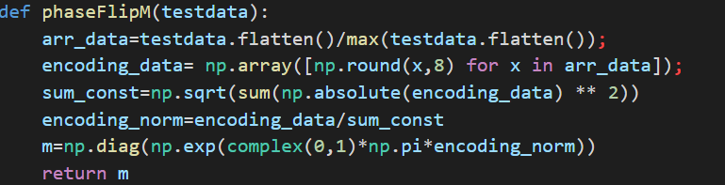
Example of codes

Slide 6
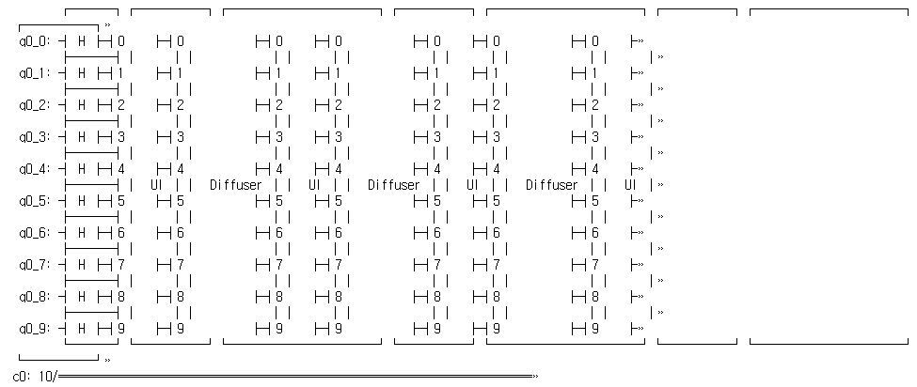
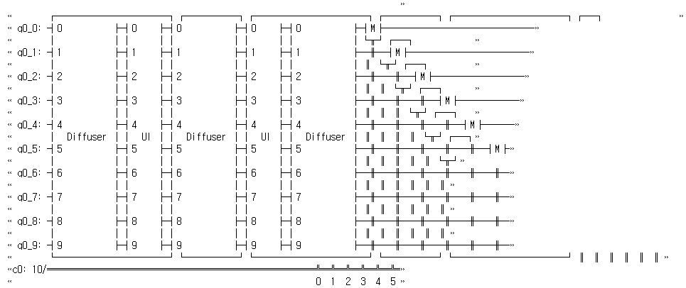
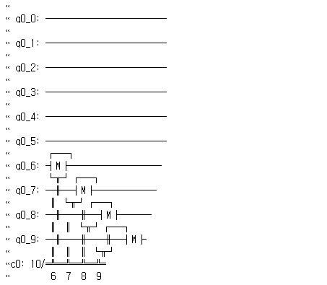
Example of codes

Slide 7
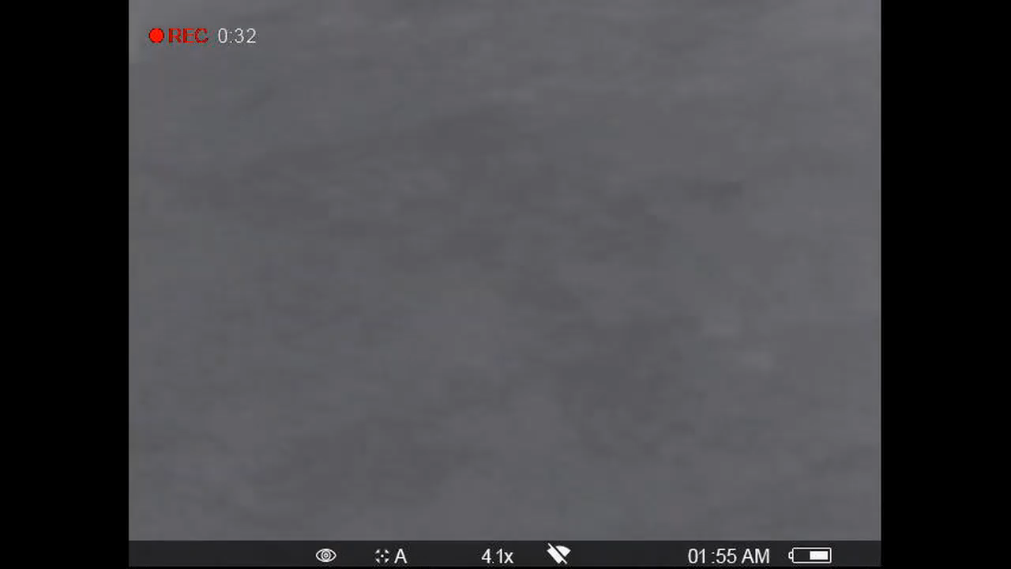

Slide 8
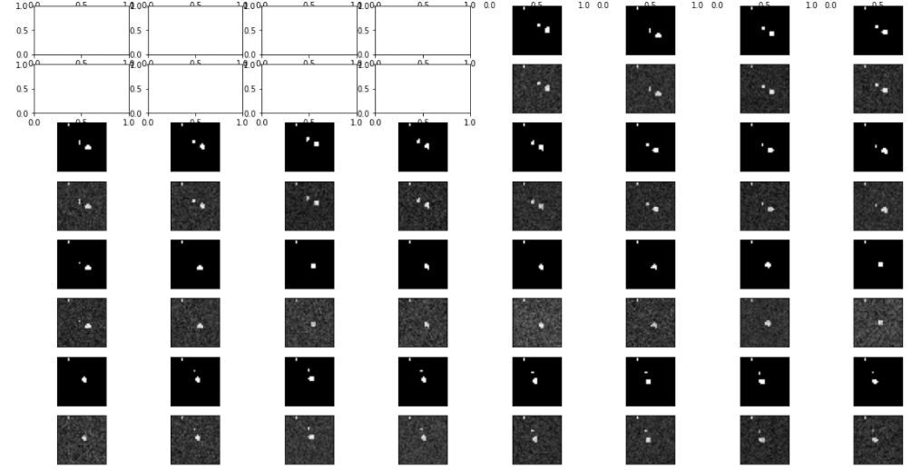
Results

Slide 9
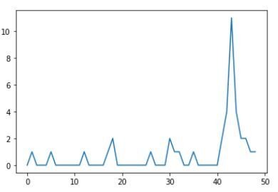
Results

Slide 10
Conclusion
Grover Algorithm can detect rapid change of images
If the performance of quantum computer improves, it can be applied to more advanced image segmentations with higher frames and various pixels.
Since Grover algorithm has quadratic speed up over classical computer for finding the unique dataset, this algorithm can be very useful for detecting the suspicious activity from the image.

Slide 11
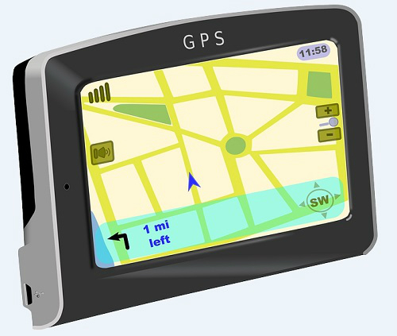


Further Study
Traffic volume
Measure the traffic volume for navigation
Tracking criminals using car
Infrared camera
Applying it to quarantine system
Security part such as detecting strangers
Using it in satellite to detect the certain phenomenon on Earth
Environmental problems like forest fire
National security such as detecting a missile

Slide 12
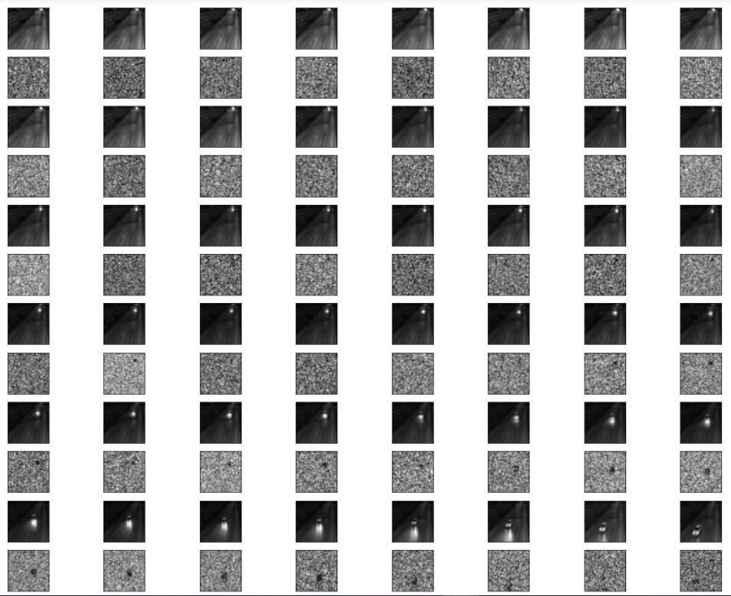
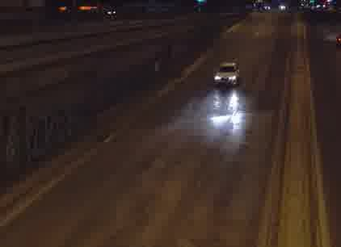
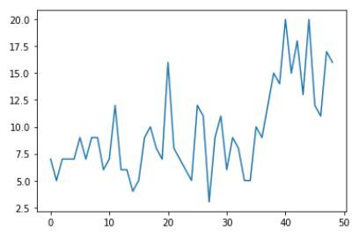
Another Results

Slide 13
